Slide 1
Chapter 7

Slide 2
Objectives

Slide 3
Objectives (cont.)

Slide 4
Objectives (cont.)

Slide 5
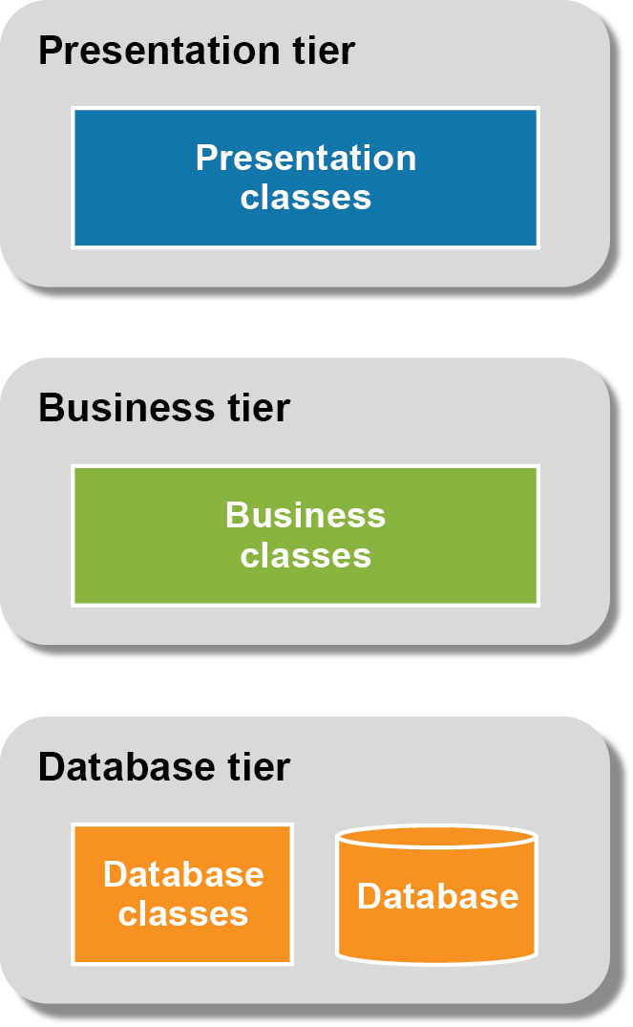
The architecture of a three-tiered application

Slide 6
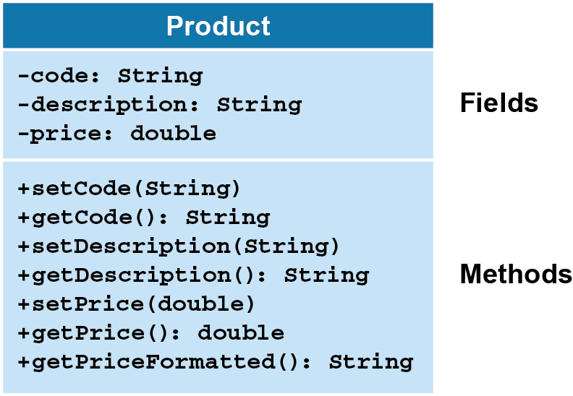
A class diagram for the Product class

Slide 7
UML diagramming notes

Slide 8
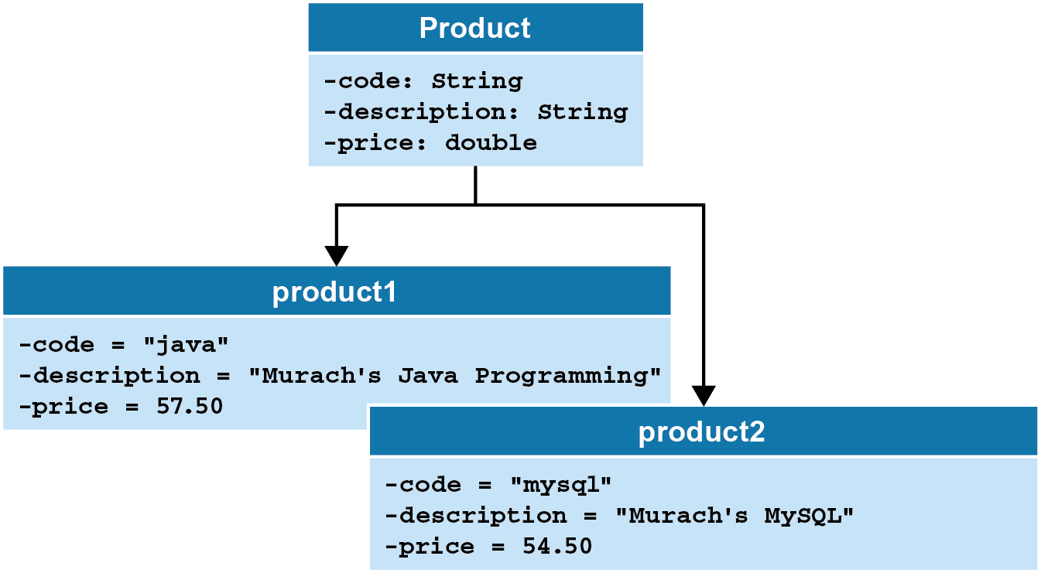
The relationship between a class and its objects

Slide 9
The dialog box for creating a new Java class

Slide 10
The Product class

Slide 11
The Product class (cont.)

Slide 12
The Product class (cont.)

Slide 13
The syntax for declaring instance variables

Slide 14
Where you can declare instance variables

Slide 15
The syntax for coding constructors

Slide 16
A constructor that assigns default values

Slide 17
A custom constructor with three parameters

Slide 18
A constructor with one parameter

Slide 19
The syntax for coding a method

Slide 20
A method that doesn’t accept parameters or return data

Slide 21
A get method that returns a string

Slide 22
A set method

Slide 23
How to create an object in two statements

Slide 24
How to create an object in one statement

Slide 25
How to call a method

Slide 26
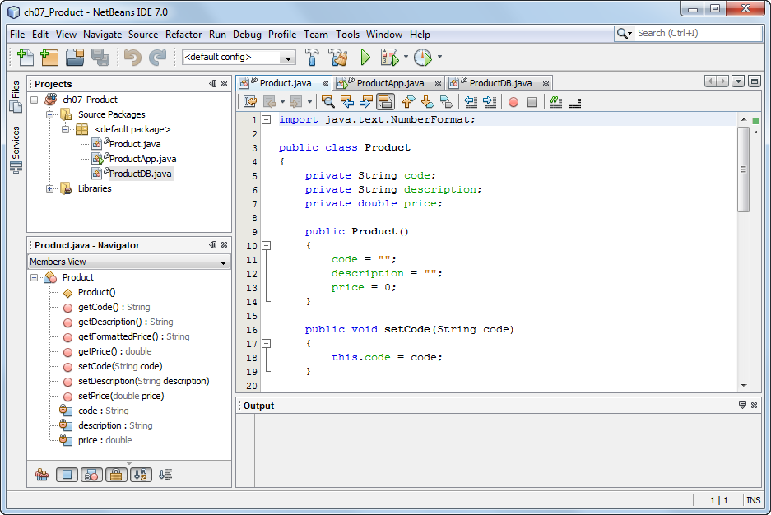
The NetBeans window for the Product application

Slide 27
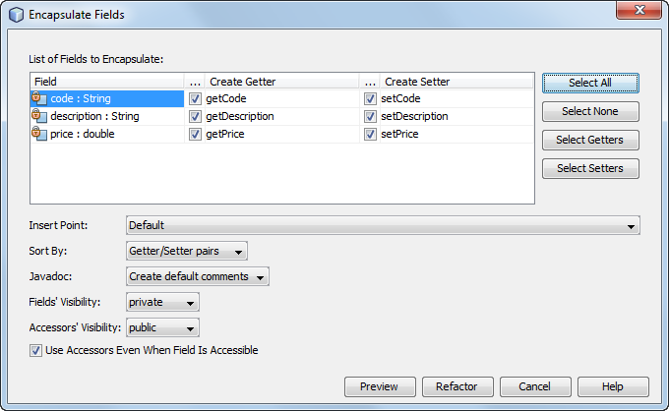
Dialog box for generating get and set methods

Slide 28
How to declare static fields

Slide 29
A class with a static constant and a static method

Slide 30
The Product class with a static variable and a static method

Slide 31
The Product class with a static variable and a static method (cont.)

Slide 32
The syntax for calling a static field or method

Slide 33
How to call static fields

Slide 34
How to call static methods

Slide 35
The syntax for coding a static initialization block

Slide 36
A class with a static initialization block

Slide 37
A class with a static initialization block (cont.)

Slide 38
The ProductDB class

Slide 39
The ProductDB class (cont.)

Slide 40
The console for the Product Viewer application

Slide 41
The ProductApp class

Slide 42
The ProductApp class (cont.)

Slide 43
How assignment statements work

Slide 44
How parameters work

Slide 45
How method calls work

Slide 46
A method that accepts one argument

Slide 47
Code that calls the printToConsole() methods

Slide 48
How to refer to instance variables of the current object

Slide 49
How to call a constructor of the current object

Slide 50
How to call a method of the current object

Slide 51
How to pass the current object to a method

Slide 52
The console for the Line Item application

Slide 53
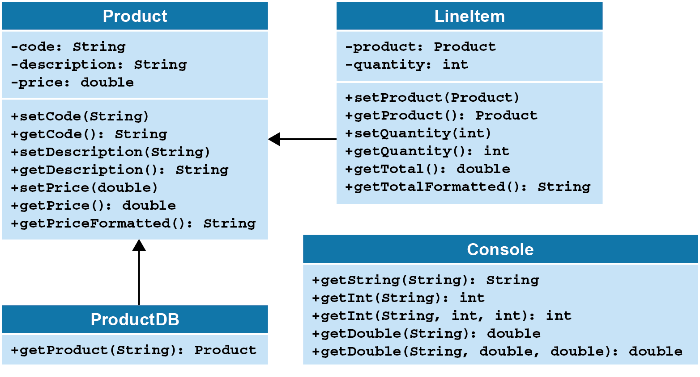
The class diagram for the Line Item application

Slide 54
The LineItemApp class

Slide 55
The LineItemApp class (cont.)

Slide 56
The LineItemApp class (cont.)

Slide 57
The Console class

Slide 58
The Console class (cont.)

Slide 59
The Console class (cont.)

Slide 60
The Console class (cont.)

Slide 61
The Console class (cont.)

Slide 62
The LineItem class

Slide 63
The LineItem class (cont.)

Slide 64
The LineItem class (cont.)

